Slide 1

Osan AB Shuttle
Shuttle is operated between the hours of:
0530-0900, 1030-1330, and 1500-1800
Monday-Friday (Except US Federal and FW Down Days)

Slide 2

Mustang Shuttle
AM Schedule (0530-0900)
Main Gate | Bldg. 473/ Parking Garage | Bldg. 384/ SFS | Bldg. 778/ Base Hospital | 7 AF/ MPS/ Finance | BX/IPE/ Bowling Alley | Bldg. 1235/ Flight Line | Bldg. 1601/ Flight Line | Mustang Center
0530 | 0532 | 0533 | 0535 | 0537 | 0539 | 0541 | 0542 | 0545
0550 | 0552 | 0553 | 0555 | 0557 | 0559 | 0601 | 0602 | 0605
0610 | 0612 | 0613 | 0615 | 0617 | 0619 | 0621 | 0622 | 0625
0630 | 0632 | 0633 | 0635 | 0637 | 0639 | 0641 | 0642 | 0645
0650 | 0652 | 0653 | 0655 | 0657 | 0659 | 0701 | 0702 | 0705
0710 | 0712 | 0713 | 0715 | 0717 | 0719 | 0721 | 0722 | 0725
0730 | 0732 | 0733 | 0735 | 0737 | 0739 | 0741 | 0742 | 0745
0750 | 0752 | 0753 | 0755 | 0757 | 0759 | 0801 | 0802 | 0805
0810 | 0812 | 0813 | 0815 | 0817 | 0819 | 0821 | 0822 | 0825
0830 | 0832 | 0833 | 0835 | 0837 | 0839 | 0841 | 0842 | 0845
0850 | 0852 | 0852 | 0855 | 0857 | 0859 | 0901 | 0902 | END
**-/+ 5 minutes f/each stop

Slide 3
Main Gate Shuttle
AM Schedule (0530-0900)
Mustang Center | Bldg. 1601/ Flight Line | Bldg. 1235/ Flight Line | BX/IPE/ Bowling Alley | 7 AF/ MPS/ Finance | Bldg. 778/ Base Hospital | Bldg. 384/ SFS | Bldg. 473/ Parking Garage | Main Gate
0530 | 0532 | 0533 | 0535 | 0537 | 0539 | 0541 | 0542 | 0545
0550 | 0552 | 0553 | 0555 | 0557 | 0559 | 0601 | 0602 | 0605
0610 | 0612 | 0613 | 0615 | 0617 | 0619 | 0621 | 0622 | 0625
0630 | 0632 | 0633 | 0635 | 0637 | 0639 | 0641 | 0642 | 0645
0650 | 0652 | 0653 | 0655 | 0657 | 0659 | 0701 | 0702 | 0705
0710 | 0712 | 0713 | 0715 | 0717 | 0719 | 0721 | 0722 | 0725
0730 | 0732 | 0733 | 0735 | 0737 | 0739 | 0741 | 0742 | 0745
0750 | 0752 | 0753 | 0755 | 0757 | 0759 | 0801 | 0802 | 0805
0810 | 0812 | 0813 | 0815 | 0817 | 0819 | 0821 | 0822 | 0825
0830 | 0832 | 0833 | 0835 | 0837 | 0839 | 0841 | 0842 | 0845
0850 | 0852 | 0852 | 0855 | 0857 | 0859 | 0901 | 0902 | END
**-/+ 5 minutes f/each stop

Slide 4
Mustang Shuttle
AM Schedule (1030-1330)
Main Gate | Bldg. 473/ Parking Garage | Bldg. 384/ SFS | Bldg. 778/ Base Hospital | 7 AF/ MPS/ Finance | BX/IPE/ Bowling Alley | Bldg. 1235/ Flight Line | Bldg. 1601/ Flight Line | Mustang Center
1030 | 1032 | 1033 | 1035 | 1037 | 1039 | 1041 | 1042 | 1045
1050 | 1052 | 1053 | 1055 | 1057 | 1059 | 1101 | 1102 | 1105
1110 | 1112 | 1113 | 1115 | 1117 | 1119 | 1121 | 1122 | 1125
1130 | 1132 | 1133 | 1135 | 1137 | 1139 | 1141 | 1142 | 1145
1150 | 1152 | 1153 | 1155 | 1157 | 1159 | 1201 | 1202 | 1205
1210 | 1212 | 1213 | 1215 | 1217 | 1219 | 1221 | 1222 | 1225
1230 | 1232 | 1233 | 1235 | 1237 | 1239 | 1241 | 1242 | 1245
1250 | 1252 | 1253 | 1255 | 1257 | 1259 | 1301 | 1302 | 1305
1310 | 1312 | 1313 | 1315 | 1317 | 1319 | 1321 | 1322 | END
**-/+ 5 minutes f/each stop

Slide 5
Main Gate Shuttle
AM Schedule (1030-1330)
Mustang Center | Bldg. 1601/ Flight Line | Bldg. 1235/ Flight Line | BX/IPE/ Bowling Alley | 7 AF/ MPS/ Finance | Bldg. 778/ Base Hospital | Bldg. 384/ SFS | Bldg. 473/ Parking Garage | Main Gate
1030 | 1032 | 1033 | 1035 | 1037 | 1039 | 1041 | 1042 | 1045
1050 | 1052 | 1053 | 1055 | 1057 | 1059 | 1101 | 1102 | 1105
1110 | 1112 | 1113 | 1115 | 1117 | 1119 | 1121 | 1122 | 1125
1130 | 1132 | 1133 | 1135 | 1137 | 1139 | 1141 | 1142 | 1145
1150 | 1152 | 1153 | 1155 | 1157 | 1159 | 1201 | 1202 | 1205
1210 | 1212 | 1213 | 1215 | 1217 | 1219 | 1221 | 1222 | 1225
1230 | 1232 | 1233 | 1235 | 1237 | 1239 | 1241 | 1242 | 1245
1250 | 1252 | 1253 | 1255 | 1257 | 1259 | 1301 | 1302 | 1305
1310 | 1312 | 1313 | 1315 | 1317 | 1319 | 1321 | 1322 | END
**-/+ 5 minutes f/each stop

Slide 6
Mustang Shuttle
PM Schedule (1500-1800)
Main Gate | Bldg. 473/ Parking Garage | Bldg. 384/ SFS | Bldg. 778/ Base Hospital | 7 AF/ MPS/ Finance | BX/IPE/ Bowling Alley | Bldg. 1235/ Flight Line | Bldg. 1601/ Flight Line | Mustang Center
1500 | 1501 | 1503 | 1505 | 1507 | 1509 | 1512 | 1513 | 1515
1520 | 1521 | 1523 | 1525 | 1527 | 1529 | 1532 | 1533 | 1535
1540 | 1541 | 1543 | 1545 | 1547 | 1549 | 1552 | 1553 | 1555
1600 | 1601 | 1603 | 1605 | 1607 | 1609 | 1612 | 1613 | 1615
1620 | 1621 | 1623 | 1625 | 1627 | 1629 | 1632 | 1633 | 1635
1640 | 1641 | 1643 | 1645 | 1647 | 1649 | 1652 | 1653 | 1655
1700 | 1701 | 1703 | 1705 | 1707 | 1709 | 1712 | 1713 | 1715
1720 | 1721 | 1723 | 1725 | 1727 | 1729 | 1732 | 1733 | 1735
1740 | 1741 | 1743 | 1745 | 1747 | 1749 | 1752 | 1753 | END
**-/+ 5 minutes f/each stop

Slide 7
Main Gate Shuttle
PM Schedule (1500-1800)
Mustang Center | Bldg. 1601/ Flight Line | Bldg. 1235/ Flight Line | BX/IPE/ Bowling Alley | 7 AF/ MPS/ Finance | Bldg. 778/ Base Hospital | Bldg. 384/ SFS | Bldg. 473/ Parking Garage | Main Gate
1500 | 1502 | 1503 | 1505 | 1507 | 1509 | 1511 | 1512 | 1515
1520 | 1522 | 1523 | 1525 | 1527 | 1529 | 1531 | 1532 | 1535
1540 | 1542 | 1543 | 1545 | 1547 | 1549 | 1551 | 1552 | 1555
1600 | 1602 | 1603 | 1605 | 1607 | 1609 | 1611 | 1612 | 1615
1620 | 1622 | 1623 | 1625 | 1627 | 1629 | 1631 | 1632 | 1635
1640 | 1642 | 1643 | 1645 | 1647 | 1649 | 1651 | 1652 | END
1700 | 1701 | 1703 | 1705 | 1707 | 1709 | 1712 | 1713 | 1715
1720 | 1721 | 1723 | 1725 | 1727 | 1729 | 1732 | 1733 | 1735
1740 | 1741 | 1743 | 1745 | 1747 | 1749 | 1752 | 1753 | END
**-/+ 5 minutes f/each stop

Slide 8
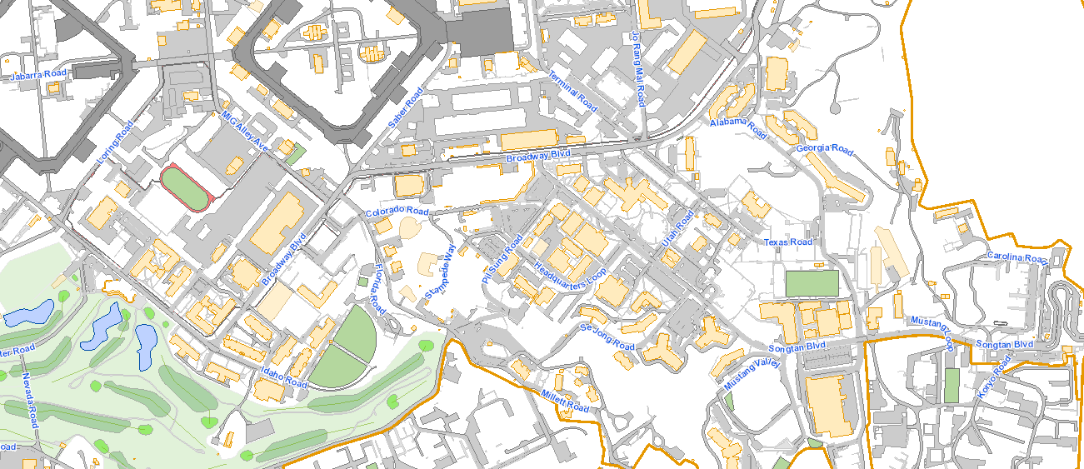
BLUE SHUTTLE ROUTE
(Heads to Mustang Center)
UNCLASSIFIED // CONTROLLED UNCLASSIFIED INFORMATION
BX
Mustang
Main
Gate
UNCLASSIFIED // CONTROLLED UNCLASSIFIED INFORMATION

Slide 9
ORANGE SHUTTLE ROUTE
(Heads to Main Gate)
UNCLASSIFIED // CONTROLLED UNCLASSIFIED INFORMATION
BX
Mustang
Main
Gate
UNCLASSIFIED // CONTROLLED UNCLASSIFIED INFORMATION

