Slide 1
WELCOME
TRAIN to GAIN
For Parents
Laying A Strong Foundation for tomorrow’s leaders by providing opportunities for learning and growth through sports and fitness.
Notes:
1

Slide 2
Youth Sports & Fitness
Staff Introductions
    Youth Sports Director – Mallory Hylton
    Youth Sports Assistant Director- Edan Ulukivaiola
Notes:
2

Slide 3
Mission Statement
We develop, facilitate and oversee programs that foster children’s social, physical, character and leadership development. In nurturing children’s capacity to learn life skills while enjoying team sports, we also strive to deepen children’s commitment to pro-social values such as kindness, helpfulness, personal responsibility, and respect for others – qualities we believe are essential to leading humane and productive lives in society.
Notes:
3

Slide 4
PHILOSOPHY
Focus on participation; instructional
Help youth develop physical, emotional
and social skills
Placing winning and losing in a healthy
perspective
Defining success as striving for the best that they can do
Notes:
4

Slide 5
GOALS
Familiarize youth with the fundamentals
Provide opportunity for participation
Emphasis on good sportsmanship, fair play, and discipline
Instill in youth the values associated with team sports, make new friends and have FUN
Notes:
5

Slide 6
YOUTH DEVELOPMENT STRATEGY
Building A Team
  Allow everyone to play every position
  Give them a chance to lead warm-ups or run a special play
Build Character
  Set Goals
  Learn From Mistakes
  Teach players how to handle pressure
Notes:
6

Slide 7
SPORTSMANSHIP
Respect your opponent
Role model
  Shake hands (or fist bump) with opposing coach
  Compliment opposing team
  Show respect toward officials
Continuously discuss importance of good sportsmanship
Ignore conduct from opposing team – don’t become part of the problem
Notes:
7

Slide 8
The Value of Sports
Lessons learned
Fundamentals
  Ethics
  Abiding by the rules
  Winning and losing with grace
  Coping with success and failure
  Respecting authority figures
  Always striving to do your best
Notes:
8

Slide 9
The Value of Sports
According To Youth
Research - * Sports Participation *
  Have fun
  Something they’re good at
  Improve skills
  Excitement of competition
  Stay in shape
  Challenge of competition
  Make new friends
  Get exercise
  Learn new skills
  Play as part of a team
  Higher level of competition
Notes:
9
Youth Sports aren’t held to the same high standard as the educational system.
Example: plays and spelling bees: adults aren’t allowed to yell at children who forget their lines or misspell a word.
Why is similar behavior tolerated in youth sports when a children drops a ball or misses a tackle?

Slide 10
The Value of Sports
Research
Higher levels of self-esteem
Lower levels of depression
More positive body image
Higher states of psychological well being
Learn about teamwork, goal-setting, experience of success, pursuit of excellence, how to deal with failures
Notes:
10
Battle overweight problems - less likely to battle overweight problems as an adult.
One of five children is overweight in US
Only about 1/3 of elementary school students have any type of daily physical education

Slide 11
CHILD ABUSE IN
YOUTH SPORTS
Benching Less Skilled Athletes
Grabbing Players by their facemasks or equipment
Cursing, yelling, or using “put-downs” that demean a child
Using excessive physical training techniques to punish/discipline young athletes
Name calling
Not allowing water or bathroom breaks
Throwing Equipment
Paying attention to the best players only
Notes:
11

Slide 12
AIR FORCE CHILD AND YOUTH PROGRAMS
POSITIVE GUIDANCE AND APPROPRIATE TOUCH INSTRUCTIONAL GUIDE
OVERVIEW:
  Children/youth need guidance from adults to keep them safe, encourage development of self-control, self-reliance and respect for the rights of others. These skills are crucial to their future success as adults. Guidance of child/youth behavior is ongoing and requires skill and patience.
Notes:
12

Slide 13
AIR FORCE CHILD AND YOUTH PROGRAMS
POSITIVE GUIDANCE AND APPROPRIATE TOUCH INSTRUCTIONAL GUIDE
(Continued)
Touch is as necessary as food or water for children/youth to thrive and grow physically, cognitively, socially, and emotionally.
Appropriate touch respects the personal privacy and space of children/youth; is nurturing (hugs, giving high-fives, etc.); keeps children/youth safe (separating physically conflicting children/youth, examining cuts/bruises/unusual marks, administering first aid to injuries); and assists with hygiene (face and hand washing, diaper changing, etc.).
Remember, the age and individual needs and preferences of the child/youth should always be considered when determining if a touch is appropriate.
Notes:
13

Slide 14
AIR FORCE CHILD AND YOUTH PROGRAMS
POSITIVE GUIDANCE AND APPROPRIATE TOUCH INSTRUCTIONAL GUIDE
(Continued)
Incidents of inappropriate guidance/touch are reported, using the AF CYP Reportable Incidents Report Form, to the Flight Chief, Family Advocacy, Squadron Commander, Major Command Specialist/Installation Support Division, Air Force Personnel Center Directorate of Services Child and Youth Programs, and Headquarters United States Air Force Child and Youth Programs within 24 hours of occurrence.
Notes:
14

Slide 15
AIR FORCE CHILD AND YOUTH PROGRAMS
POSITIVE GUIDANCE AND APPROPRIATE TOUCH INSTRUCTIONAL GUIDE
(Continued)
APPROPRIATE GUIDANCE TECHNIQUES:
- Consider Possible Reasons for Behaviors
- Listening
- Understanding Development
- Providing Opportunities for Choices
- Establishing Limits and Rules
- Anticipating and Preventing Challenging Behaviors
- Indirect Guidance
- Reinforcement
- Redirection
Notes:
15

Slide 16
AIR FORCE CHILD AND YOUTH PROGRAMS
POSITIVE GUIDANCE AND APPROPRIATE TOUCH INSTRUCTIONAL GUIDE
(Continued)
APPROPRIATE GUIDANCE TECHNIQUES:
- Intentional Environments
- Logical and Natural Consequences
- Conflict Resolution
- Providing Language to Identify Expressions of Emotions
- Modeling Prosocial Behaviors
- Be in Control without Being Overly Controlling
Notes:
16

Slide 17
AIR FORCE CHILD AND YOUTH PROGRAMS
POSITIVE GUIDANCE AND APPROPRIATE TOUCH INSTRUCTIONAL GUIDE
(Continued)
INAPPROPRIATE GUIDANCE TECHNIQUES:
CYP personnel never use threats or derogatory remarks about children/youth or their families.
At all times, children/youth should be free from criticism, repression and punishment. Therefore, the following techniques are unacceptable for use by any adult (including parents) in CYP.
  NOTE: This list is not all-inclusive. Remember, any act that risks harming a child/youth physically or psychologically are not permitted in CYP.
Notes:
17

Slide 18
AIR FORCE CHILD AND YOUTH PROGRAMS
POSITIVE GUIDANCE AND APPROPRIATE TOUCH INSTRUCTIONAL GUIDE
(Continued)
INAPPROPRIATE GUIDANCE TECHNIQUES:
Spanking, slapping, biting, hitting, pinching, yanking, shoving, shaking, pulling hair or any other form of physical abuse
Threats, name-calling, sarcasm, belittling, teasing or any other form of verbal abuse
Isolation away from adult contact/sight
Confinement in closets, boxes or similar places
Binding to restrain movement of mouth or limbs
Withholding or forcing meals, snacks, toileting, outdoor play experiences or rest time
Allowing children/youth to remain in soiled or wet clothing
Intimidating a child with facial expression, tone of voice or a physical presence (ex. standing over them, finger pointing)
Touching children/youth in uncomfortable or inappropriate ways, such as: tickling, kissing, forced goodbye hugs/kisses, fondling or touching genitals (except when necessary to clean a child who has soiled himself/herself)
Coercion or other forms of exploitation of a child’s lack of knowledge
Notes:
18

Slide 19
AIR FORCE CHILD AND YOUTH PROGRAMS
POSITIVE GUIDANCE AND APPROPRIATE TOUCH INSTRUCTIONAL GUIDE
(Continued)
BEHAVIOR SUPPORT PLANS:
It might be time to consider a behavior support plan when children/youth display behaviors that are consistent, intense and/or put themselves or others at risk. The plan should include a mix of strategies which build relationships between the child/youth, staff and family, reduces the need for conflict, and teaches them to be successful in their relationships with others.
A behavior support plan should be developed with the understanding that adults (including parents/guardians) in the life of the child/youth recognize the individual needs and challenges of the child/youth and are going to provide support and understanding to assist in their development of social and emotional skills. There will need to be changes and compromises in order for a plan to be effective. In addition, everyone will have to be accountable for trying new things. A good plan outlines everyone’s responsibilities and provides the time for change to occur.
Notes:
19

Slide 20
PARENT RESPONSIBILITIES AND EXPECTATIONS
To the children
  Unwavering support, including positive reinforcement
To the coaches
  Keep coaches informed about absences (i.e., illness, school, church, or family functions)
  Be supportive of decisions and understanding
To the league
  Report situations that arise, evaluate coaches
To other parents
  Competition and taunting between parents not acceptable
To themselves
  Enjoy watching your child participate and learn
Notes:
20

Slide 21
Guidelines for a
Coach – Parent Partnership
Don’t put the player in the middle.
Give feedback.
Don’t give instructions during a game.
Provide positive support for their player.
Be part of the “home court advantage” for the team.
Don’t disparage the other team.

Slide 22
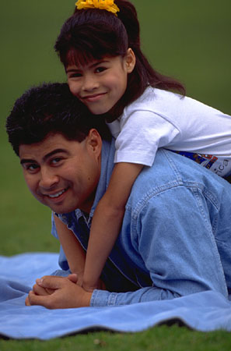
How Parents Can Help
Communicate with team.
Check players in at practice (take attendance)
Provide treats for games.
Display good sportsmanship.
Help collect balls during practice
Time keeping during a game

Slide 23

Communication
On everyone’s part is the key to success.
  If your going to be late to practice.
  If your going to be missing practice.
  If you have prior commitments.
Notes:
23

Slide 24

Volunteers & Coaches
Volunteers are:
Certified through the National Association for Youth Sports (NAYS)
Screened to create an emotionally, physically and sexually safe environment
Trained to motivate with praise and specific instruction and to keep games free from put downs, trash talk and profanity
Instructed in how to minimize the consequences of injuries until medical help is provided.

Slide 25
HEALTH AND SAFETY
Everyone must share responsibility
  Alcohol, smoking, dipping, chewing tobacco, or such will not be allowed during any Youth sports & Fitness event or activities.
  Profane or derogatory language will not be tolerated.
  All players should wear appropriate clothing
    No shorts or jeans with pockets or belt loops
    Hand carry sport specific shoes
Notes:
25

Slide 26

HEALTH AND SAFETY
What should your child eat before practices or games
Small amounts and light foods 1 ½ hours prior to practice/game (fruit, pasta)
Avoid soft drinks, candy and heavy foods which can make a child feel sluggish
Consume a balanced diet of protein, carbohydrates and fats.
Have healthy snacks after games if you do snack.

Slide 27
PROGRAM SPECIFICS
Age Divisions – Required 2 Year Age Span
  5-6 Developmental – No Scores or Standing Kept (parents must remain at all practices and games)
  7-8 Instructional – No Scores or Standings Kept (parents must remain at all practices and games)
  9-10 Organization– Team Building (Youth may sign selves in and out)
  11+ Skill Enhancement (Youth may sign selves in and out)
Physicals and immunizations Required to register and for continued participation
Notes:
27

Slide 28

SEASON SPECIFICS
GUESTS IN FACILITIES
Ensure safekeeping of the facility
Children supervised at all times – includes sibling(s) – not running around
Theft or damage to property will not be tolerated
Cleaned and left the way you found it – remove all trash, clothing and bags
Notes:
28

Slide 29
Unsportsmanlike conduct of the parents and coaches
  Coaches Not Playing Kids Fairly
  Unacceptable Yelling at the children
  Derogatory comments from parents in bleachers
  Overly competitive parents & coaches
  Yelling at referees/umpires
  “Win At ALL COST” Attitude
Notes:
29

Slide 30
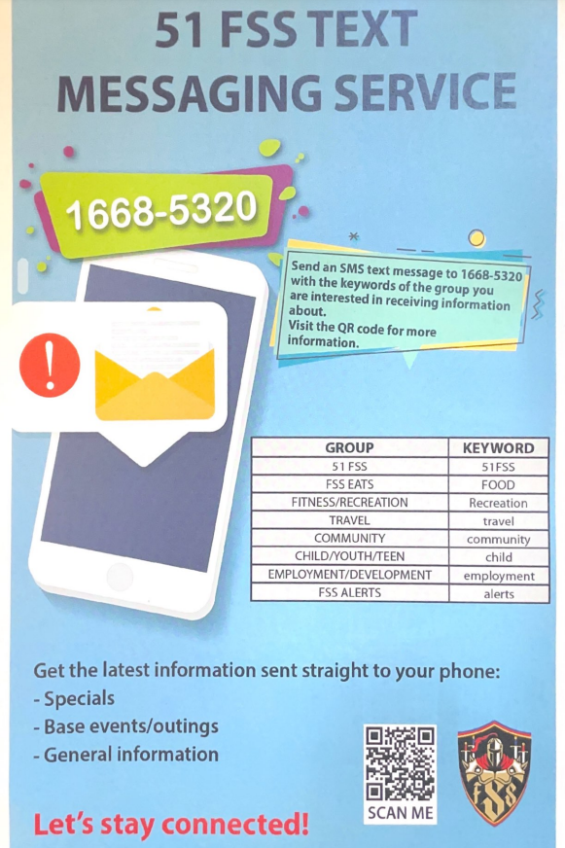
Weather Policies
Youth Sports practices will only be cancelled/ rescheduled due to:
Thunder
Lightening
Precipitation that inhibits visibility
Unsafe field conditions
AQI over 150
The call will be made by the sports director one hour before the scheduled practice or game time. Keep an eye out as notifications will be made through email, text message and our facebook page.
As always, families are always encouraged to make the best decisions for their families.

Slide 31

Most Commonly Asked Questions
Notes:
31

Slide 32
What Equipment Do I Need?
Clean Sneakers
Baseball Glove
Baseball Socks
Baseball Pants
Notes:
32

Slide 33

WHAT DO MY REGISTRATION FEES COVER?
Uniforms
End of season certificates and medals
NAYS Coaches Certification
Coaches CPR/AED and First Aid Training
Safety Gear & Equipment
Staff Payroll
Program Primarily Supported By Parent Fees
Notes:
33

Slide 34
Reminders
Remember, it’s not about winning – it’s about developing ALL children to their fullest potential.
Remember, when they reach the high school or college level, these children may not be playing in the position that you put them in now.
Children should be well aware of what each position demands and acquainted with all aspects of the game.
ALL players should have the opportunity to experience the “ENTIRE” game.
Notes:
34

Slide 35
INFORMATION LINE
784-1492
Osan Air Base Child and Youth Programs Facebook
51fss.fsyy.youthcenter@us.af.mil
Notes:
35

Slide 36
Let’s have a great season!
Thank You
Notes:
36

