Slide 1

Public Affairs
Social Media
Disable geotagging
What’s your social media like?
  Who is following you?
What are you posting?
  Is it critical information?
  Is it OPSEC?
  Would China want it?

Slide 2
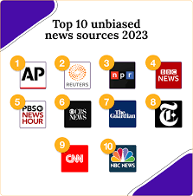
Public Affairs
Flow of Information
ROK happenings are perceived differently stateside
Where does your information come from?
  Is it a verified, neutral source?

Slide 3

Public Affairs
Stay up to date on Installation news!
Bldg 1097 (Wing HQ) Rm 235
Email: 51fwpa@us.af.mil
DSN: 784-4044

